Slide 1
Gene expression workflow for Cryptococcus hybrid samples
Kayla Wilhoit
4/15/2024

Slide 2
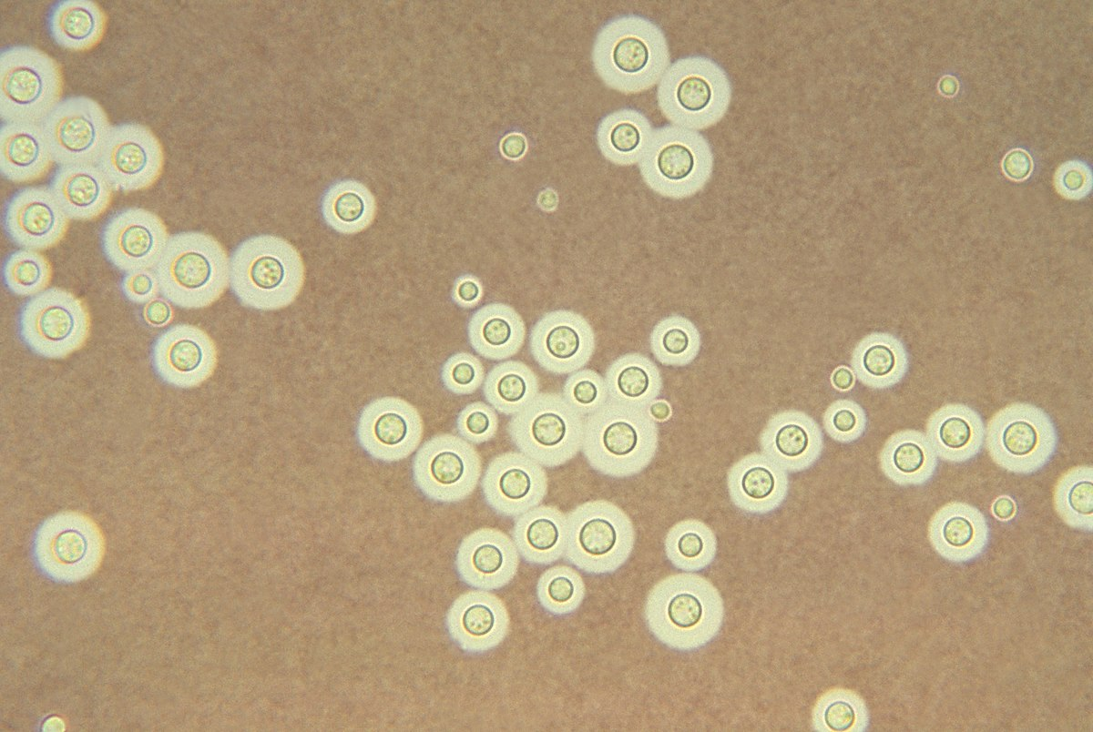
Scientific Importance
Cryptococcus neoformans
Ubiquitous fungal pathogen affecting immunocompromised patients
~1 million cases/year
~150,000 deaths/year
Limited antifungal options
Drug resistance
In-Host evolution
Aneuploidy
Hybridization with other Cryptococcus strains
Notes:
One of the main mechanisms for antifungal resistance in Cryptococcus is in-host evolution through aneuploidy.
Cryptococcus seems to be able to tolerate having multiple duplicated chromosomes or odd numbers of chromosomes, and it can also duplicate its entire genome under certain conditions.
This phenomenon has been observed many times in lab settings but is not very well characterized in real-world, clinical samples.
Duke is a great place to study cryptococcus, and we have access to over 30 years of cryptococcus cultures from patients at Duke hospital several of them being long-term chronic patients.

Slide 3
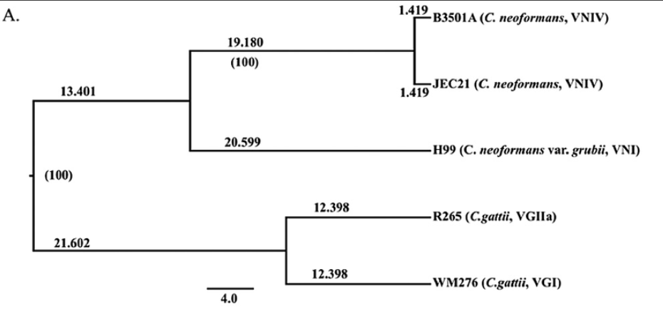
Cryptococcal Hybrids
Notes:
One of the main mechanisms for antifungal resistance in Cryptococcus is in-host evolution through aneuploidy.
Cryptococcus seems to be able to tolerate having multiple duplicated chromosomes or odd numbers of chromosomes, and it can also duplicate its entire genome under certain conditions.
This phenomenon has been observed many times in lab settings but is not very well characterized in real-world, clinical samples.
Duke is a great place to study cryptococcus, and we have access to over 30 years of cryptococcus cultures from patients at Duke hospital several of them being long-term chronic patients.

Slide 4
Cryptococcal Hybrids
Notes:
One of the main mechanisms for antifungal resistance in Cryptococcus is in-host evolution through aneuploidy.
Cryptococcus seems to be able to tolerate having multiple duplicated chromosomes or odd numbers of chromosomes, and it can also duplicate its entire genome under certain conditions.
This phenomenon has been observed many times in lab settings but is not very well characterized in real-world, clinical samples.
Duke is a great place to study cryptococcus, and we have access to over 30 years of cryptococcus cultures from patients at Duke hospital several of them being long-term chronic patients.

Slide 5
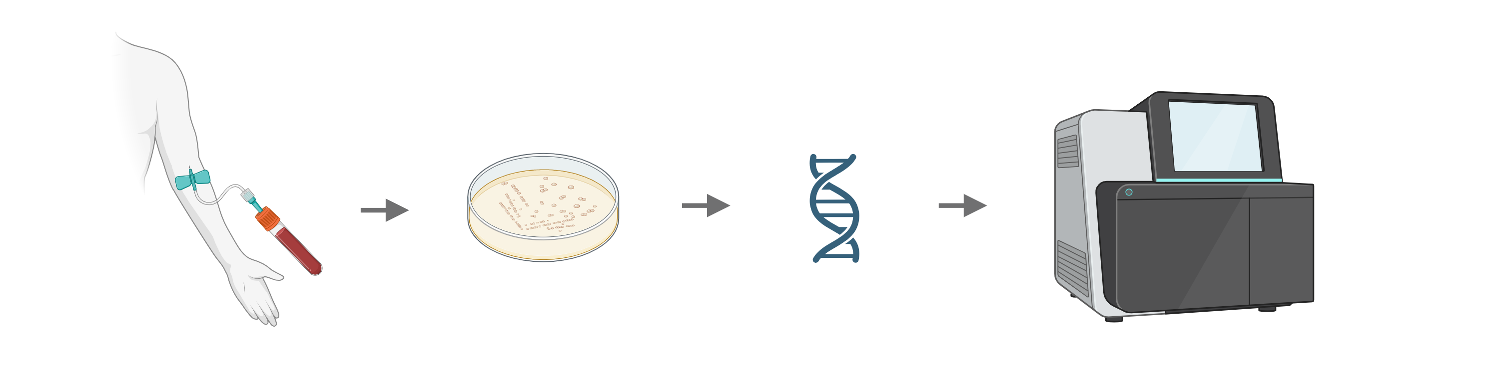
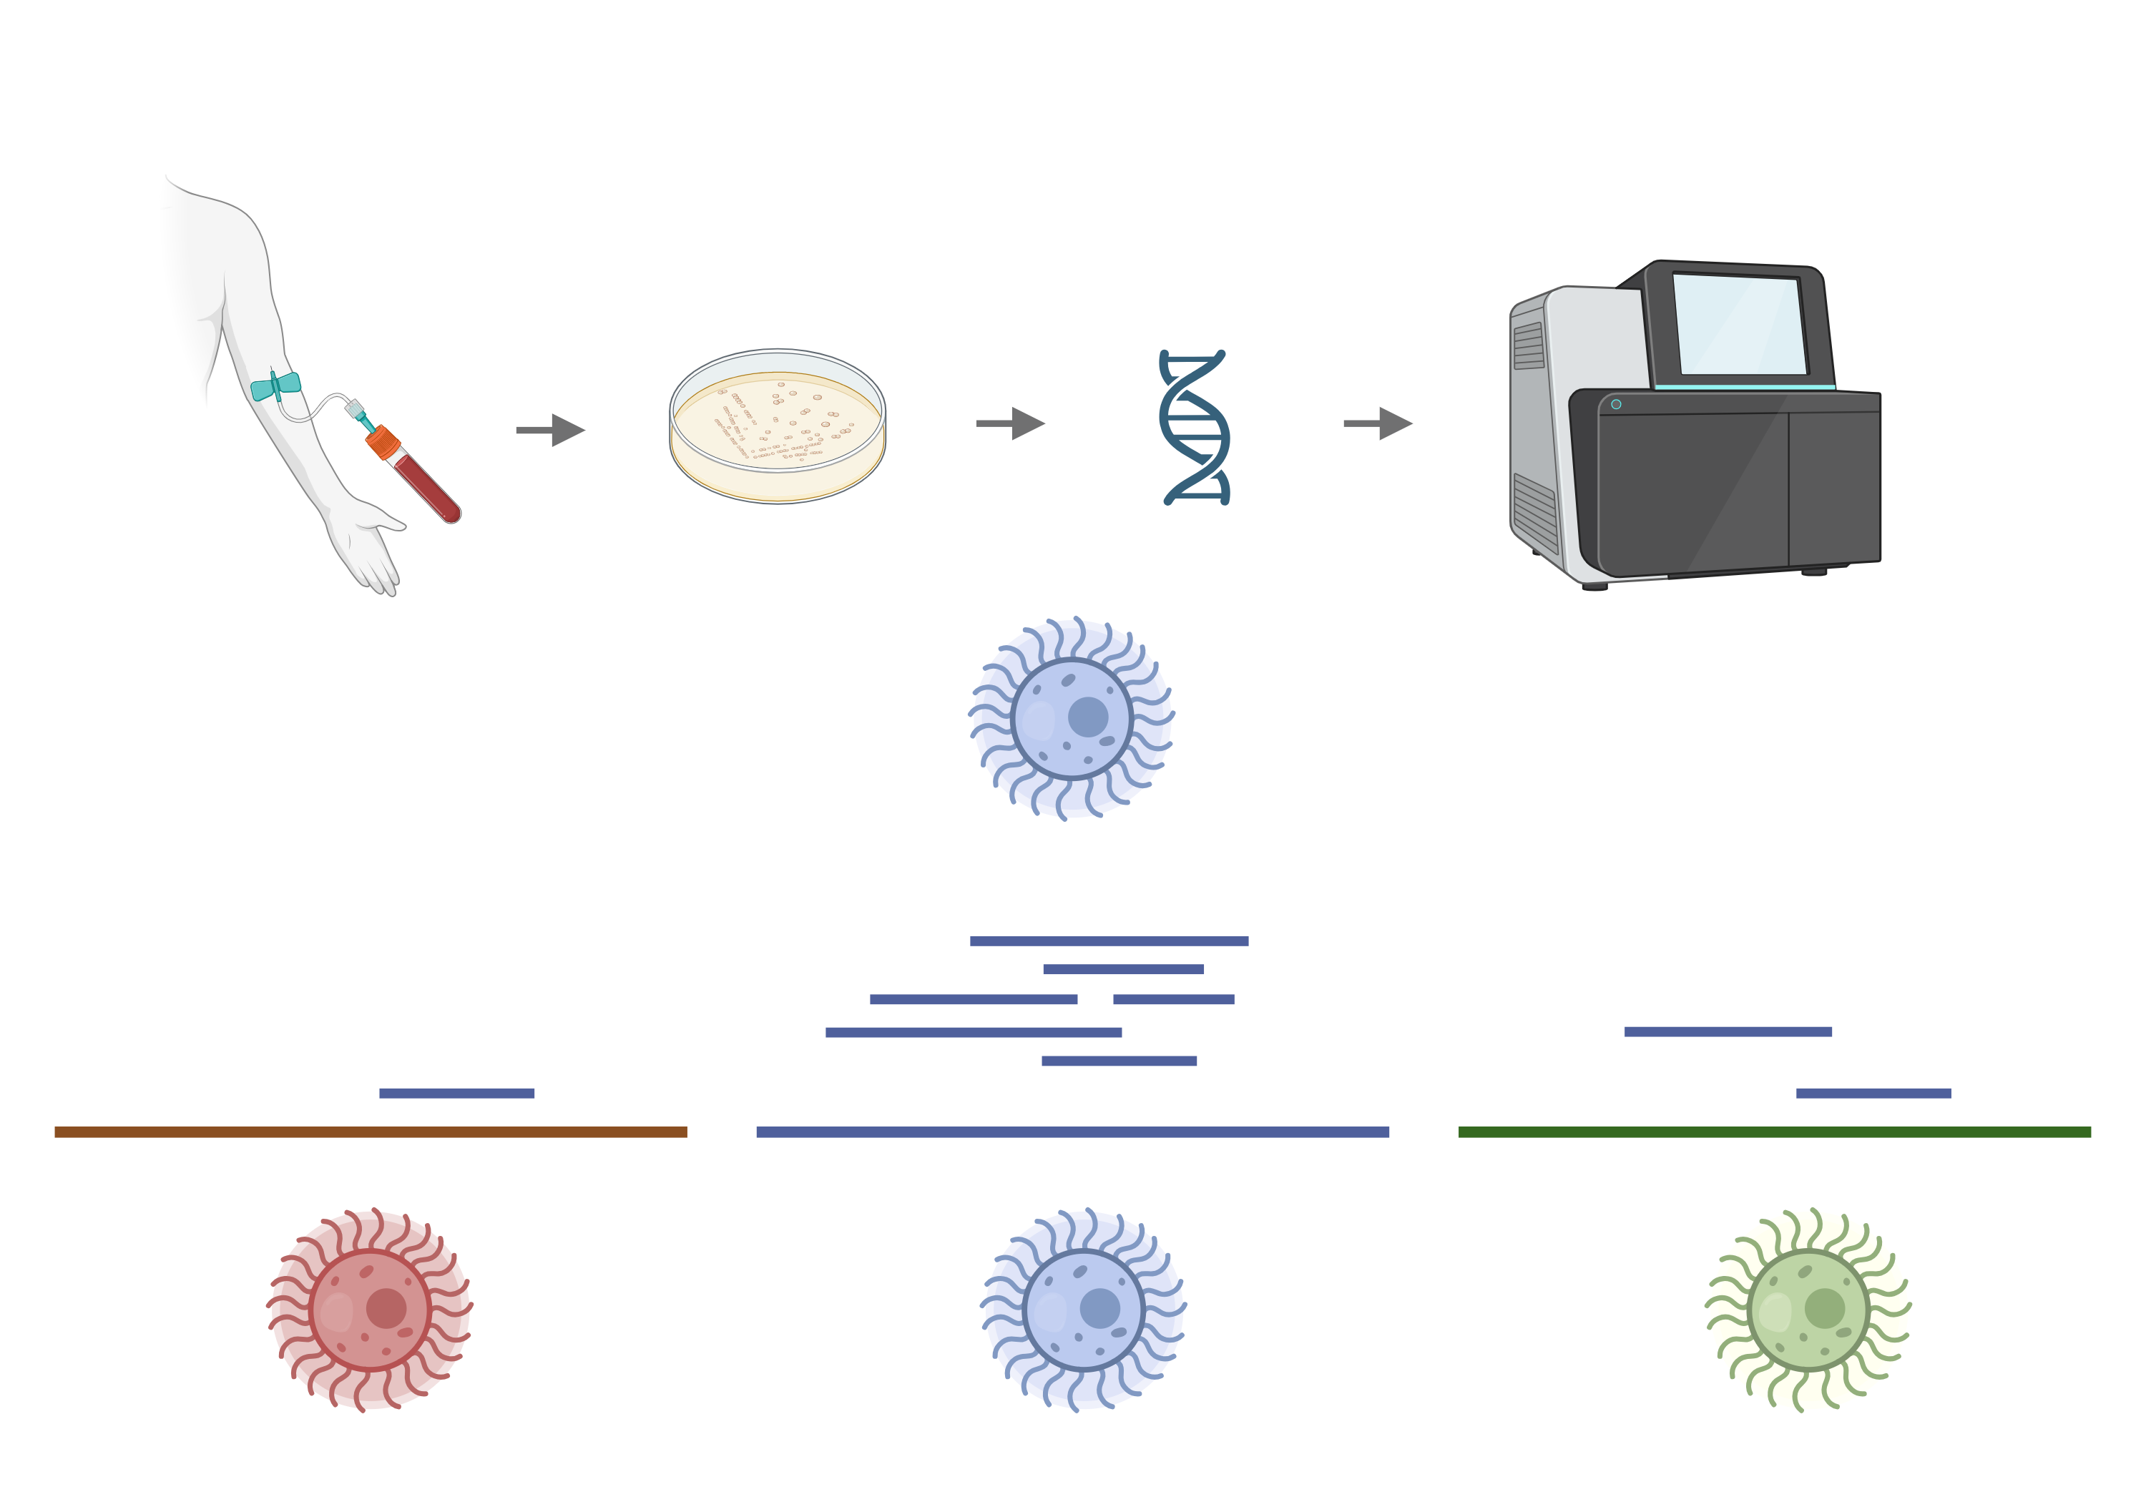
Previous analysis of clinical Cryptococcus samples
Preserved cultures isolated and sequenced with Illumina short-read sequencing
Sample reads mapped to genomes of all sequenced Cryptococcus strains
Read depth analysis to find structural variants
Best match
Notes:
This is the first step to identify most likely lineage of clinical samples and identify potential hybrids

Slide 6
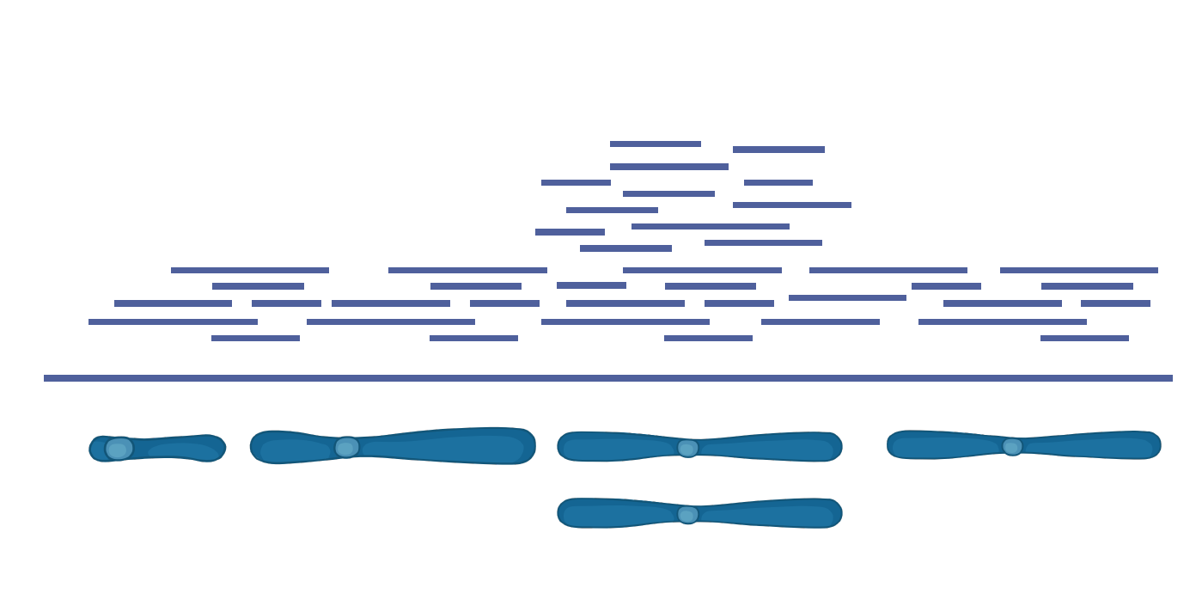
Genomic read depth analysis
Notes:
To look for potential duplications of chromosomes, I use a metric called read depth. When using short read data, there will be more short reads aligning to a particular region in the genome if there are multiple copies of a gene or chromosome.

Slide 7
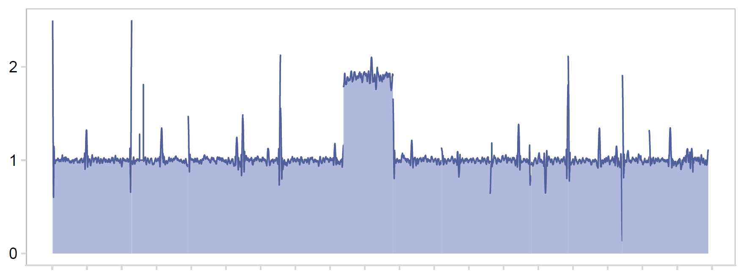
Genomic read depth analysis
Read Depth
Genome position
Notes:
Across the genome these charts look something like this, where this one region has been duplicated relative to the rest of the genome

Slide 8
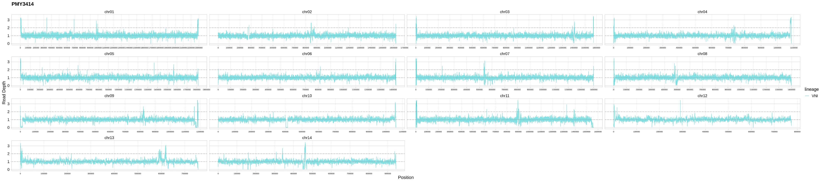

Slide 9


Slide 10
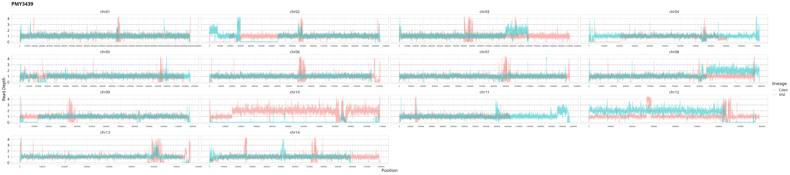
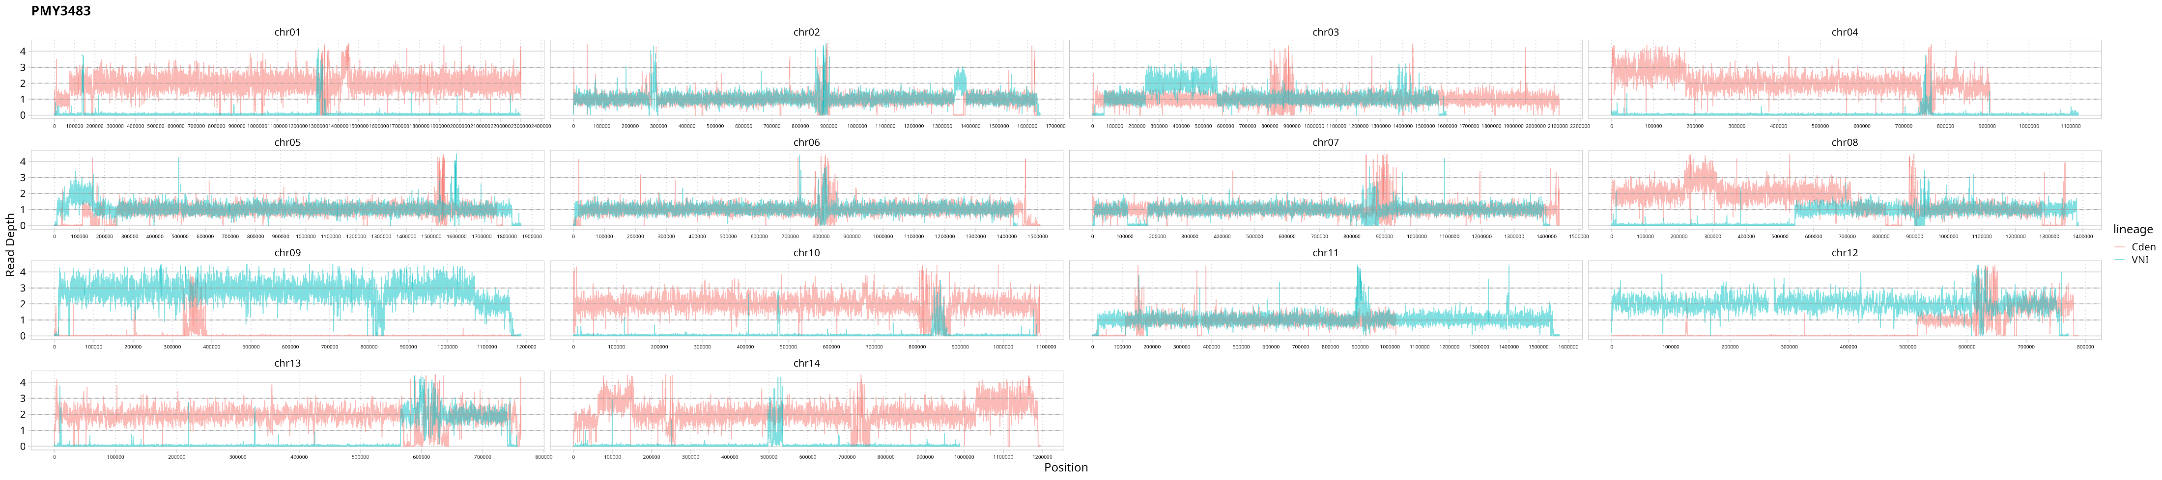

Slide 11


Slide 12
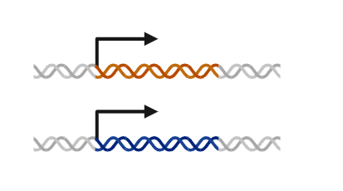
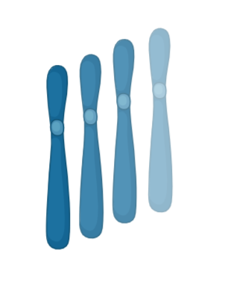
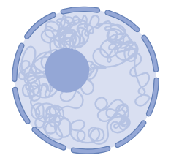
Main Questions
1) How are hybrid cryptococcus samples behaving transcriptionally?
Are parental haplotypes separately regulated?
Cis/trans effects?
Differences from synthetic hybrids?
Isoforms?
2 ) How do ploidy changes affect transcriptional regulation in clinical cryptococcus samples?
Linear increase in expression?
Differences in hybrids/nonhybrids?
3 ) How do chromosomal rearrangements affect transcriptional regulation in hybrid samples?
Cis/trans changes?
Physical interactions?

Slide 13
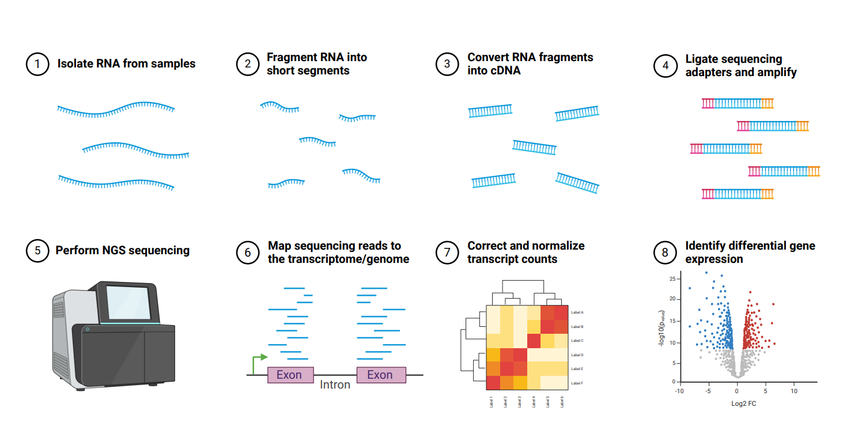
RNA-sequencing overview

Slide 14
RNA-sequencing overview

Slide 15
Analysis tools
1) How are hybrid cryptococcus samples behaving transcriptionally?
Quality control: FastQC, Trimmomatic, Cutadapt, Skewer
Read mapping/alignment: STAR, Stampy, Bowtie2
Differential expression: DESeq2, edgeR
2) How do ploidy changes affect transcriptional regulation in clinical cryptococcus samples?
Normalization: RSEM, edgeR
3) How do chromosomal rearrangements affect transcriptional regulation in hybrid samples?
de novo assembly: Trinity, Trans-ABySS, SOAPdenovo-Trans, BUSCO, DETONATE

Slide 16
Data formats
1) How are hybrid cryptococcus samples behaving transcriptionally?
RNA-sequencing
fastq raw reads and fasta reference genome
SAM/BAM files – alignment mapping
GFF/GTF files – gene annotations, isoform information
Output = Count matrix (csv)
2) How do ploidy changes affect transcriptional regulation in clinical cryptococcus samples?
3) How do chromosomal rearrangements affect transcriptional regulation in hybrid samples?
Metadata (csv/tsv) – hybrid status, ploidy estimates, known translocations
Count matrix and Normalized count matrix
Differential gene expression output = Volcano plots, etc.
Hi-C / methylation information?

Slide 17
Computing needs and workflow
Many small genomes (19 Mb) Many intermediate files that can be very large (BAM/SAM, BED, GFF)
Both temporary and long term storage needed
Workflow structure in Snakemake
Conda environments for software version consistency
Modular workflow + small genomes = not as much working memory needed
Already tested and works well on local cluster

Slide 18
Decisions
Isoforms
May depend on sequencing platform and cost
Long + short reads?
Likely to be complicated in messy hybrids
May need preliminary data first
Alignment of reads
Mostly reference-based
May also create de novo genome assemblies
Differential expression
Looking for specific genes or general patterns?
What are the significance cutoffs?

Slide 19
Statistical challenges
Normalization and differential expression
How to deal with ploidy changes?
“The overall expression of diploids was remarkably similar to that of the haploids in the same condition (r=0.94, 0.93 for S. cerevisiae and S. paradoxus, respectively) and the between-species differences were also highly correlated between the haploids and diploids (r=0.82), suggesting that the results are not affected by ploidy level”
Recombination + structural variation
Unknown area of research
May vary by strain and mating type

Slide 20
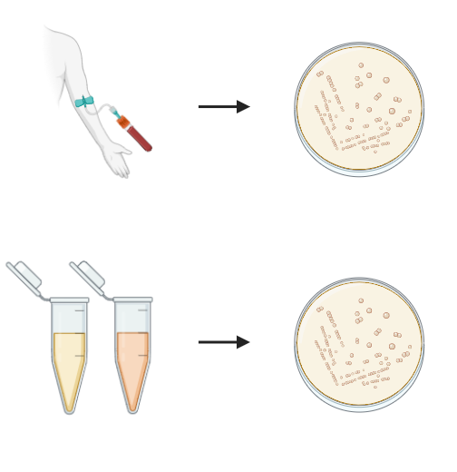
Statistical challenges
Synthetic hybrids vs. clinical hybrids
Creating in vitro hybrids = better cis/trans calling, compare early/established hybrids
Both parents known and available
May not be stable or ‘realistic’
Clinical strains may not have clear parental strains available
Could split haplotypes and treat as parents?
Could use closest sequenced strain to each haplotype?

Slide 21
Future Plans
Testing on example data
Choosing software tools
Testing with/without parents included
Testing with imputed parents from offspring haplotypes
Finding more information on current software
Isoform information
Cis/trans calling
Short + long read sequencing
Hybrid organisms
Narrowing goals
Looking for specific genes (drug resistance)
Patterns temporally/geographically

